Slide 1


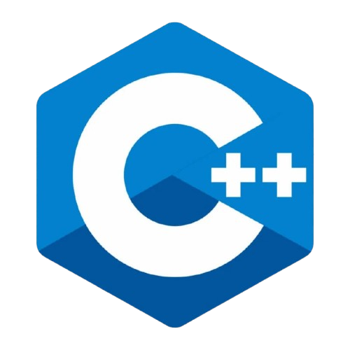
By Parthasarathi Swain

Slide 2


Session Objectives
Understand the mindset required to learn programming
Learn to compare programming with English
Appreciate the value of practice and patience

Slide 3
IQ Test
Problem Statement:
You have three buckets:
Bucket A: 8 liters (full)
Bucket B: 5 liters (empty)
Bucket C: 3 liters (empty)
Goal:
Measure exactly 4 liters of water in Bucket A or Bucket B.
A(8L)
B(5L)
C (3L)
Empty
Empty
Full

Slide 4


Real-Life Scenario – Learning Cycle
Example: How a child learns a language:
Observes letters and sounds (A, B, C)
Forms words (Cat, Dog)
Makes sentences (I love coding)
Learns grammar (Tenses, Punctuation)
Writes essays and stories
Same in Programming:
Characters → Tokens → Statements → Syntax → Full Program

Slide 5
Programming vs English Learning
English Learning | Programming Learning
Alphabets (A-Z) | Characters (A-Z, 0-9, symbols)
Words | Keywords, Identifiers
Sentences | Code Statements
Grammar | Syntax Rules
Composition | Complete Program

Slide 6

How to Learn Programming Effectively
Start with understanding logic, not just syntax
Write code yourself, don't just copy-paste
Break complex tasks into simpler parts
Learn from each error; debug patiently

Slide 7


Importance of Practice
Real Example:
Like learning to type fast – more practice = better speed
In C++, more problems = better logic
Tips:
Solve beginner programs (sum, max, even/odd)
Use platforms like HackerRank, GeeksforGeeks
Code at least 30 minutes every day

Slide 8

Be Patient – It Takes Time
Programming is a journey, not a sprint
Errors are your best teachers
Success takes time and trials

Slide 9
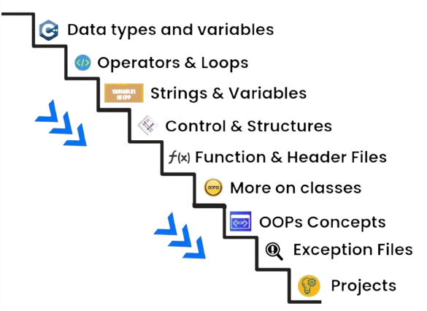
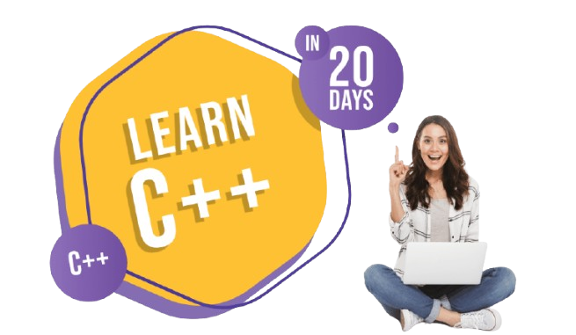
Roadmap to Learn C++

Slide 10
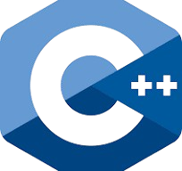
What is C++?
C++ is a high-level programming language.
Developed by Bjarne Stroustrup in 1983.
It is fast, powerful, and used in:
Game development
Operating systems (like Windows, Linux)
Banking and financial systems
Robotics and embedded systems
Real-time and performance-critical applications

Slide 11
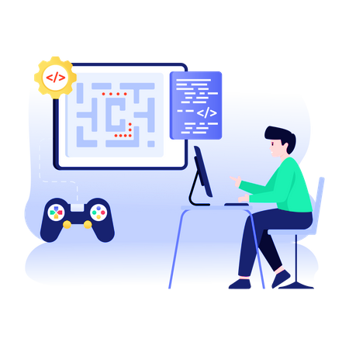
Why Choose C++?
C++ is fast, efficient, and close to hardware
Great for understanding how computers work
Builds strong base for other languages (Java, Python)
Real Use Cases:
Game Engines
Embedded Systems (microcontrollers)
Operating Systems (Windows parts)

Slide 12
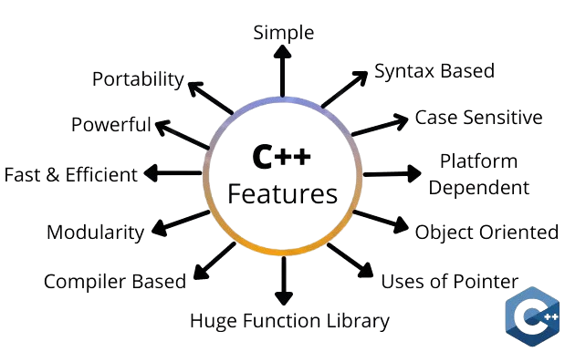
Key Features of C++

Slide 13
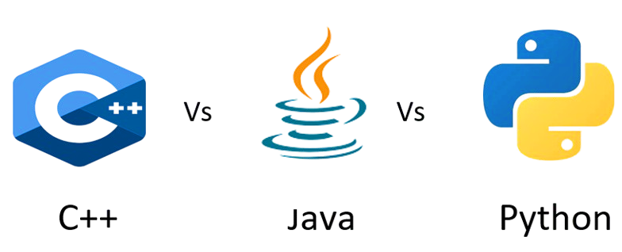
C++ vs Other Languages
Language | Speed | Syntax | Usage
C++ | 🚀 Very Fast | ⚙️ Medium | 🎮 Games, OS, Embedded
Python | 🐢 Slower | 🧠 Easy | 🧪 AI, ML, Data Science
Java | ⚡ Fast | 🧱 Moderate | 🏢 Web, Enterprise Apps

Slide 14

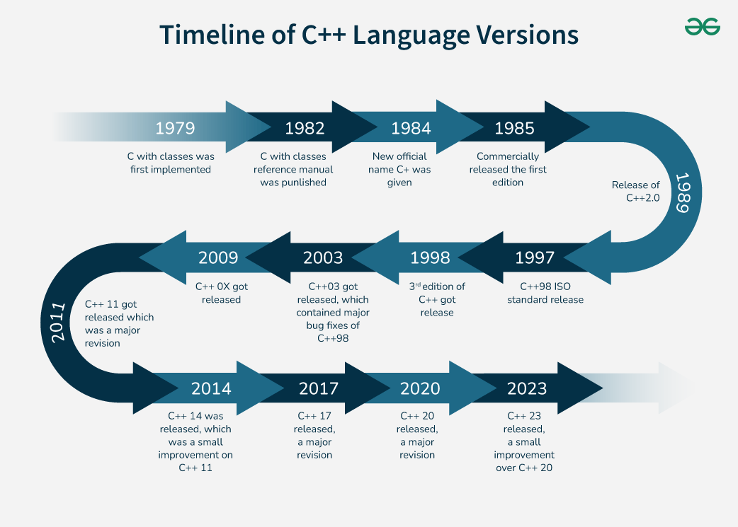
History of C++
1979 – Bjarne Stroustrup began developing C++ at Bell Labs (USA).
1983 – The language was first named “C with Classes”, later renamed C++.
C++ was built as an extension of C, adding object-oriented features.

Slide 15
Installation of C++
Step 1 – Download Dev C++
Visit: https://sourceforge.net/projects/orwelldevcpp/
Click on the Download button
File size: ~50MB
Step 2 – Run Installer
Locate the downloaded .exe file
Double-click to start installation
Choose preferred language
Click Next
Step 3 – Accept License
Read the License Agreement
Click I Agree to continue

Slide 16
Installation of C++
Step 4 – Choose Installation Folder
Default path is: C:\Program Files (x86)\Dev-Cpp
You can change the folder if needed
Click Install
Step 5 – Finish Installation
Wait for installation to complete
Click Finish
Dev C++ will launch automatically

Slide 17
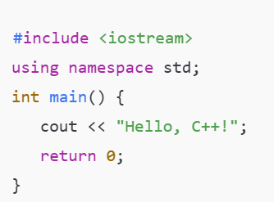
Verify Installation
Step 7 – Verify Installation
Go to File > New > Source File
Type and run this code:
Hello, C++!

Slide 18

Thank You

